Slide 1


Title: Bank management system(java swing AWT & MYSQL) Presented By: Billakanti Sindhuja Vallurupalli Madhuri Artham Vamshi Gunduka Hindu Preethi Ganji Akhil Chandra Organization: Accenture Mentors: Vikas Dishoriya Piyush Josh Naman Jain Date of Submission: 13-06-2025

Slide 2
Agenda
2
Introduction
Project Objectives
Proposed Solution
Workflow
Implementation
Key Screens (UI Flow)
Database Design
Testing & Validation
Challenges & Learnings
Conclusion & Future Scope

Slide 3
Introduction
This project is a simple bank management system using java GUI.
It lets users:
1.Deposit or withdraw money 2.Check balance 3.Fast cash 4.Get mini statements (download/email) 5.Change their PIN securely employees can also approve new customers, making the system realistic and safe to use.

Slide 4
Project Objectives
Develop a user-friendly Bank Management System using Java Swing
Allow customers to securely log in and perform banking operations
Implement a multi-step signup process for new customers
Enable employees to approve or reject customer registrations
Ensure secure authentication with role-based access

Slide 5
Proposed Solution
5
Developed a Java Swing-based application with MySQL backend for managing banking operations
Implemented role-based access for employees and customers.
Enabled employees to approve or reject new customer signups.
Provided secure features like deposit, withdrawal, balance check, PIN change, and mini-statement.
Designed intuitive UI screens for seamless navigation and real-time user interaction.

Slide 6
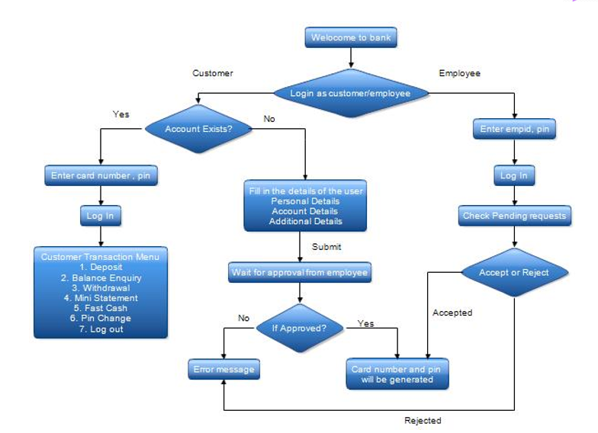
Workflow
Modules: Menu → Signup/signin → Approval → Transactions
Layers: UI (Java Swing), DB (MySQL), Logic (JDBC)

Slide 7
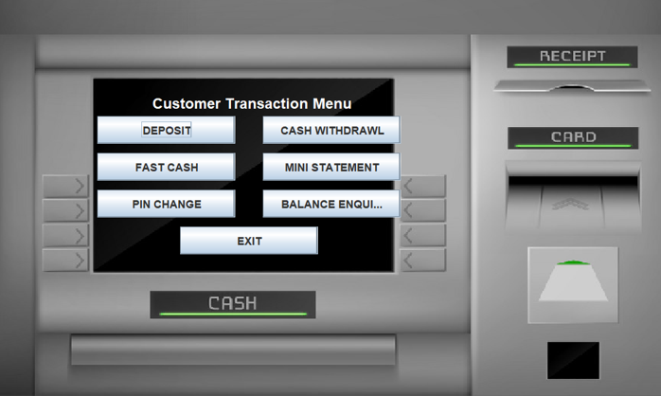
Implementation
Customer modules:
Deposit, withdraw, fast cash, balance inquiry, PIN change, mini statement
Employee modules:
Login, approval dashboard, transactions
Signup flow:
Page 1 → page 2 → page 3 → waiting for approval → approval/rejection
Tech used:
Java swing for UI with icons/images
MYSQL (JDBC) for backend integration

Slide 8
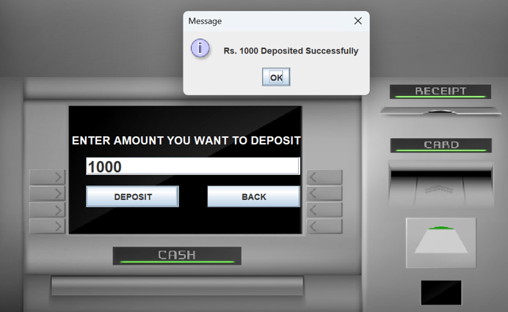
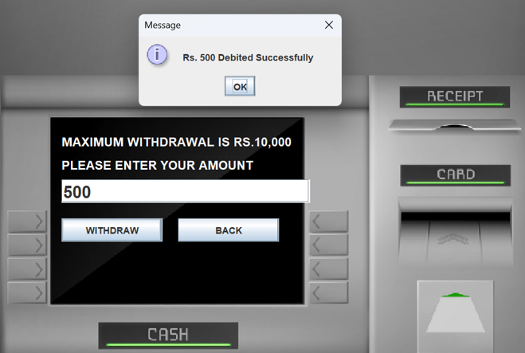
Key Screens(UI Flow)
Deposit:
Cash withdraw

Slide 9
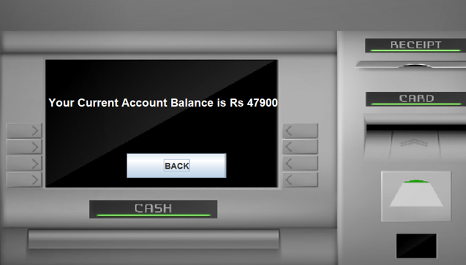
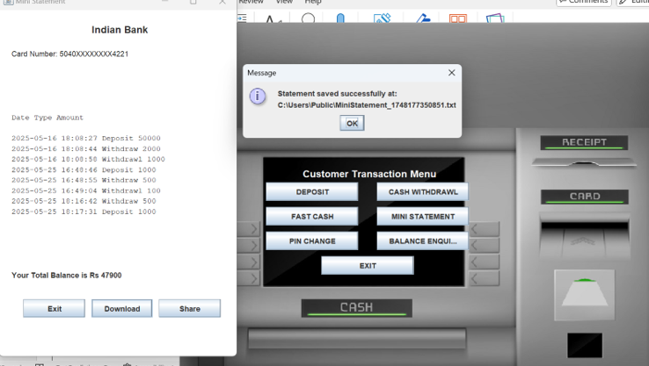
UI Screens
Balance enquiry:
Mini statement:

Slide 10
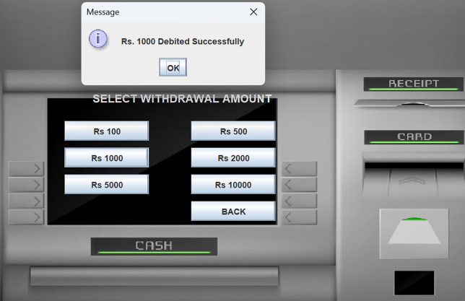
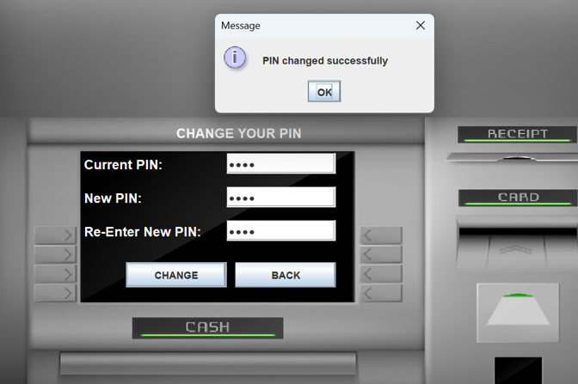
UI Screens
Fast cash:
Pin change:

Slide 11
Testing and Validation
All transaction screens tested manually through GUI
Verified PIN validation, balance checks, and error handling
Aadhar and PAN validation checked during new user registration
Approval status polling logic tested and confirmed
All database operations tested using JDBC and MySQL Workbench

Slide 12
Database Design
login – Stores card number, PIN, role (Customer/Employee)
customerdetails1 & 2 – Holds personal, contact, and demographic info
account – Captures account type for each user
bank – Logs deposits, withdrawals, with date & amount
user_access – Manages Aadhaar/PAN-based access control
signup_requests – Tracks new customer signup status (Pending/Approved/Denied)

Slide 13
Challenges and Learnings
Challenges:
Image loading errors.
Real-time UI refresh for approval
Card & PIN generation without duplicates
Learnings:
JDBC integration
Team collaboration & debugging

Slide 14
Conclusion
Simulates a real-world bank with secure workflows
Easy to extend with email approvals and encryption

Slide 15
Thank You

